Slide 1
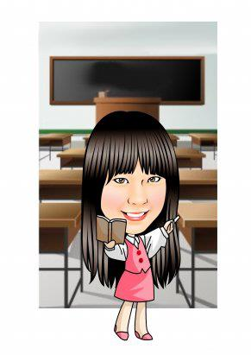
Hello, everyone!
I’m your English teacher.
My name is ________
?????

Slide 2
Listen! What is teacher’s name?

Slide 3
Are you right?
My name is Mandy.
You can call me Teacher Mandy.

Slide 4
When you hear “Mandy”, you can clap your hands.

Slide 5
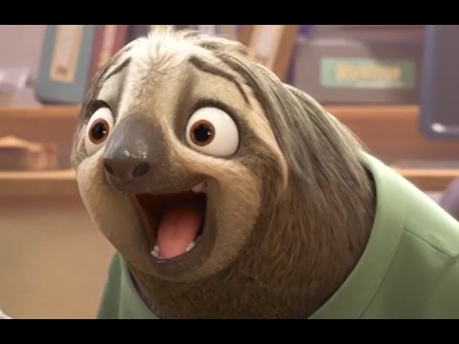
Teacher Mandy’s Classroom Rules
6 groups
Winner can get stamps
Break the rules.
No stamp!

Slide 6
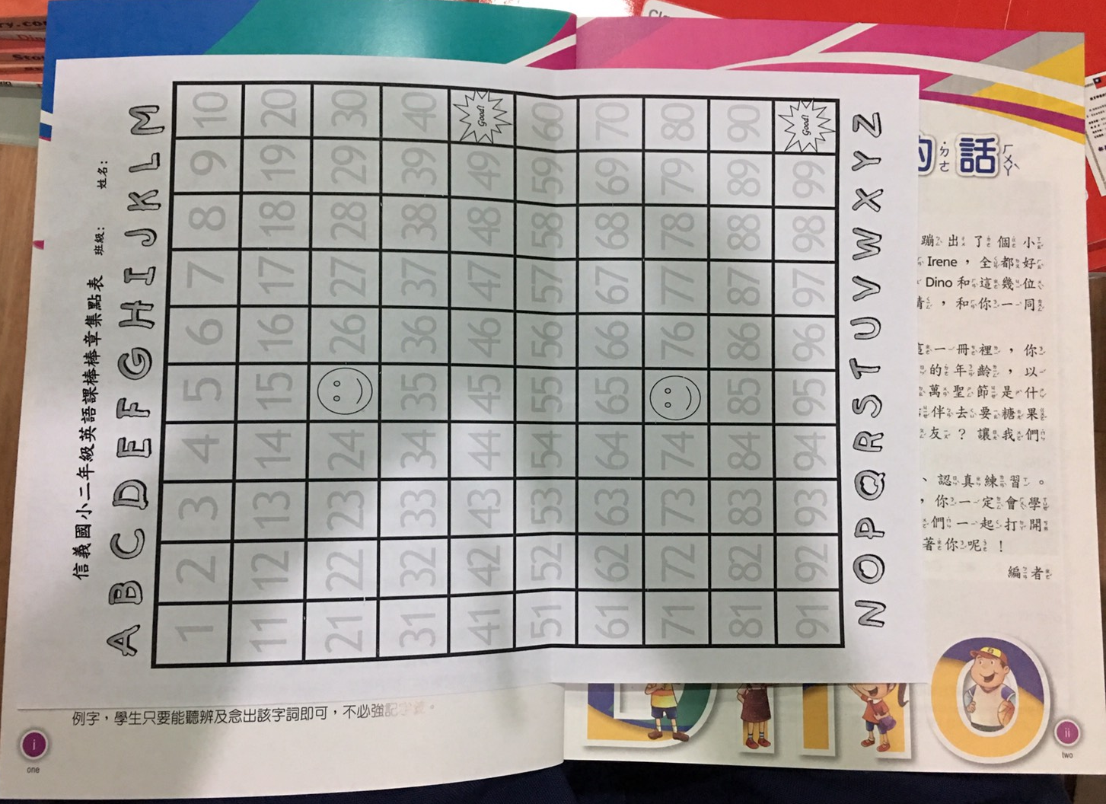
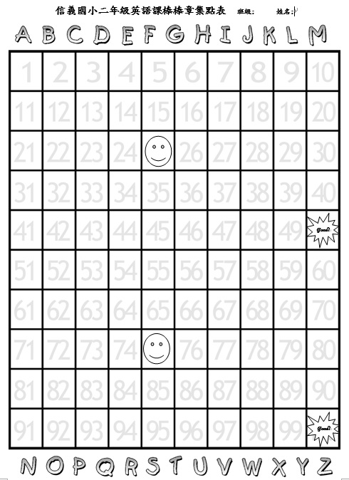
英語課的棒棒章集點表

Slide 7
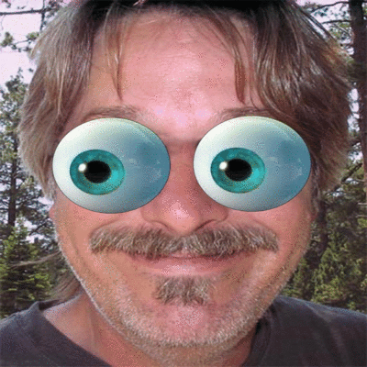
默契口號練習!
Teacher Mandy: One, two, three.
Eyes on me.
Students: One, two.
Eyes on you!

Slide 8
Write down your name
Class: 205/204
Number: 座號
Name:中文姓名+英文姓名
Teacher: (貼貼紙)

Slide 9
Write down your name
Class: 205/204
Number: 座號
Name:中文姓名+英文姓名
Teacher: (貼貼紙)

Slide 10
Write down your name
Class: 205/204
Number: 座號
Name:中文姓名+英文姓名

Slide 11
Who’s a good boy/girl?

Slide 24
Let’s be a great and powerful learner.

Slide 25
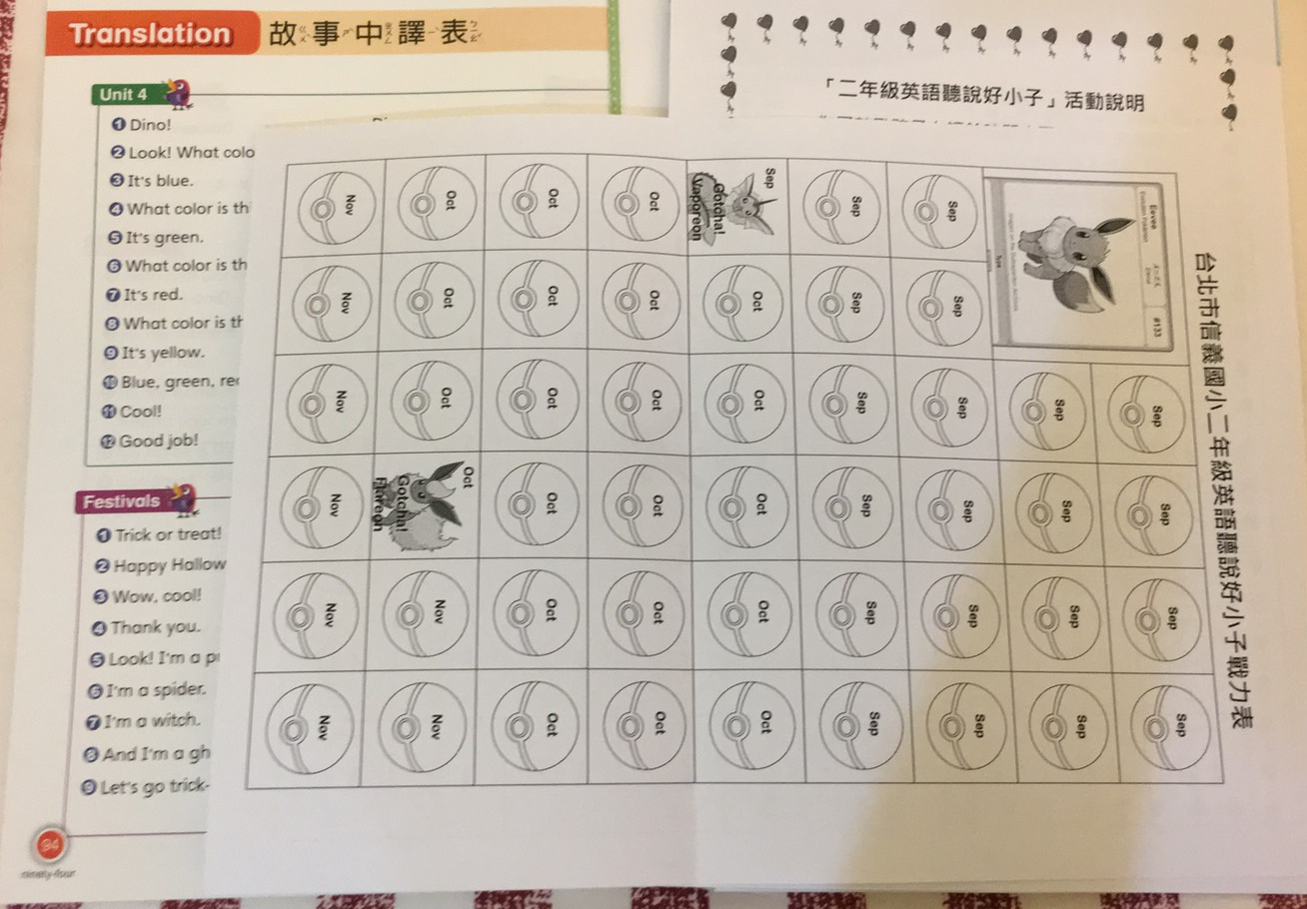
How to do?
每週Tr. Mandy會出聆聽CD&跟讀的作業，若回家有完成，請家長(不限父母)協助在認證表上簽名。
以天數記，假如小朋友這週有3天聆聽&跟讀CD，就請家長在3顆寶貝球上簽名。
老師會每個月依據完成度在班上進行Happy Hour抽獎活動。
如果已將課本內容練習得很熟，想自己聆聽其他較難的內容(如:補習班教材/英語有聲書/英語卡通/廣播/youtube…等)也可以!
若在家有聆聽CD或背單字，只是忘記將課本帶回家，還是可以再請家長補簽名認證的!不過只限當月份喔!

Slide 26
Classroom English

Slide 27
Stand up.

Slide 28
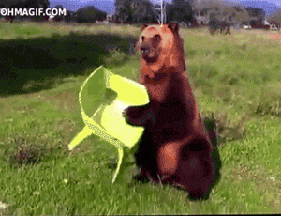
Sit down.

Slide 29
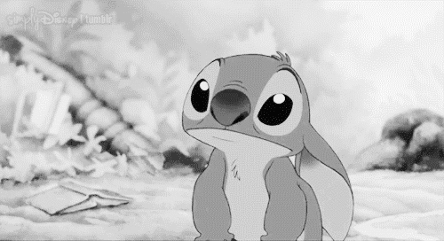
Listen!

Slide 30
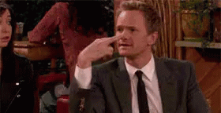
Look at me.

Slide 31
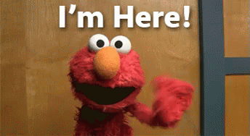
Here.
Elmo?

Slide 32
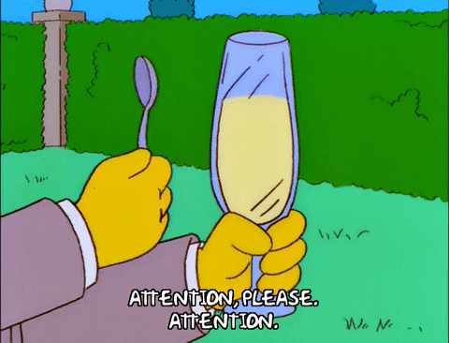
Attention!

Slide 33
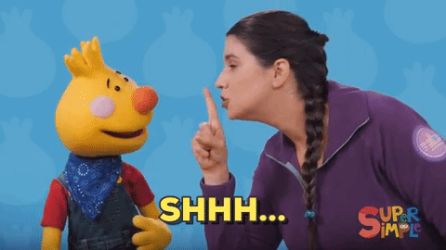
Quiet, please.

Slide 34
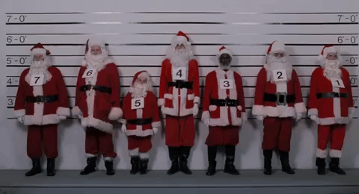
Line up.

Slide 36
Nice to meet you!

Slide 37
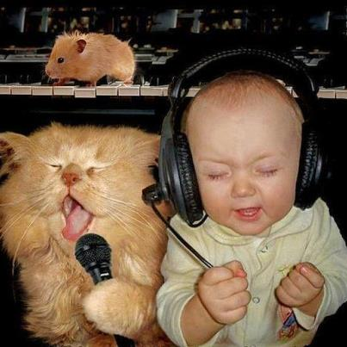
Hello Song
Hello! Hello!
Hello! What’s your name?
Hello! Hello! Hello~~~
My name is _______.
My name is _______.
Hello _____, hello _____, hello~~~
Mandy
Mandy
Mandy
Mandy

Slide 38
Let’s welcome our new friends!

Slide 39
Hello! I’m Owen.

Slide 40
Hi! My name is Danny.

Slide 41
Good morning! I’m Irene.

Slide 42
Hello, everybody! I’m Niki.

Slide 43
And me! My name is Dino.

